Slide 1
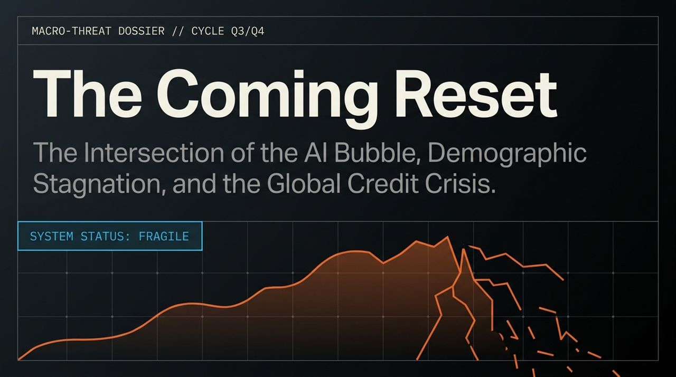
Notes:
Welcome everyone. Today we are diving into our Macro-Threat Dossier for Q3/Q4, focusing on what we identify as an imminent Systemic Reset.
The current system status is marked as FRAGILE. We are witnessing a convergence of three major structural forces:
The AI Bubble: Unprecedented capital expenditure and valuation expansion lacking end-user revenue backing.
Demographic Stagnation: Global demographic drag across major powerhouses like China, Europe, and the US.
Global Credit Crisis: The unraveling of shadow banking and private credit markets.
Macro researcher Edward Dowd compares this setup to a fragile "Jenga Tower". When a market relies heavily on leverage and continuously rising asset valuations, even a subtle deceleration in growth can bring down the entire structure.
https://www.youtube.com/watch?v=lQxDsu7L4jQ

Slide 2
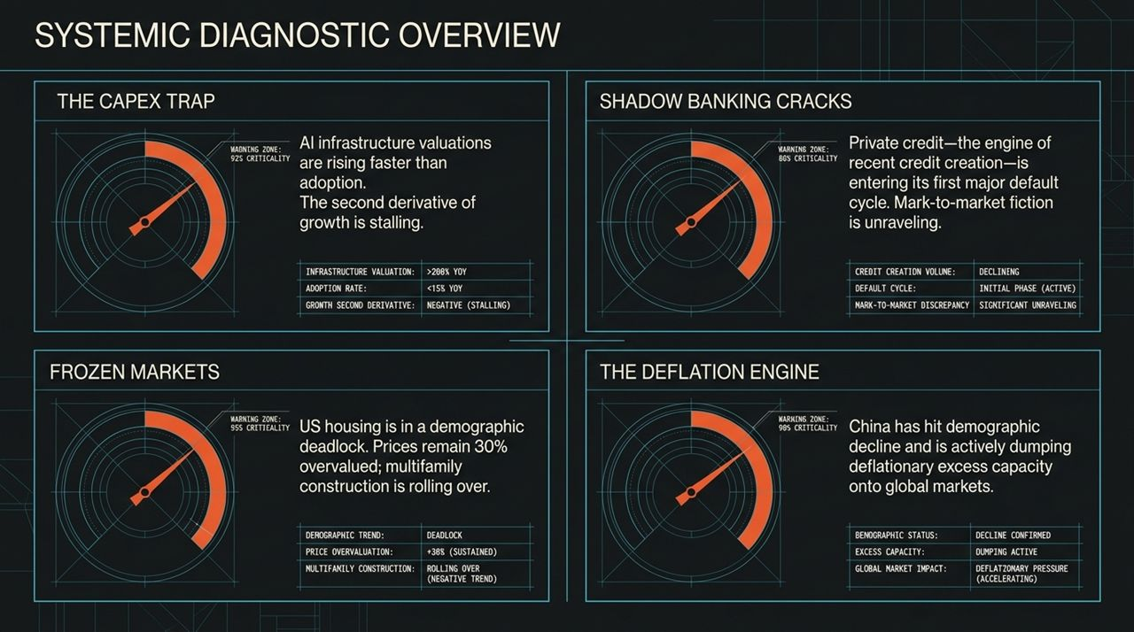
Notes:
Moving to our high-level diagnostic overview, we track four core pillars across our warning metrics:
The CapEx Trap (92% Criticality): Infrastructure valuations are soaring at over 200% YoY, while actual end-user adoption is lagging under 15% YoY. The second derivative of growth is officially stalling.
Shadow Banking Cracks (86% Criticality): Private credit—the primary engine of recent credit creation—is entering its first major default cycle. The practice of internal, non-public mark-to-market pricing is starting to unravel.
Frozen Markets / US Housing (95% Criticality): US residential real estate is in a demographic deadlock. Prices remain ~30% overvalued, and multifamily construction permits have rolled over.
The Deflation Engine / China (96% Criticality): China has passed its prime demographic peak. Facing internal consumption collapse, it is dumping deflationary excess capacity into global markets.

Slide 3
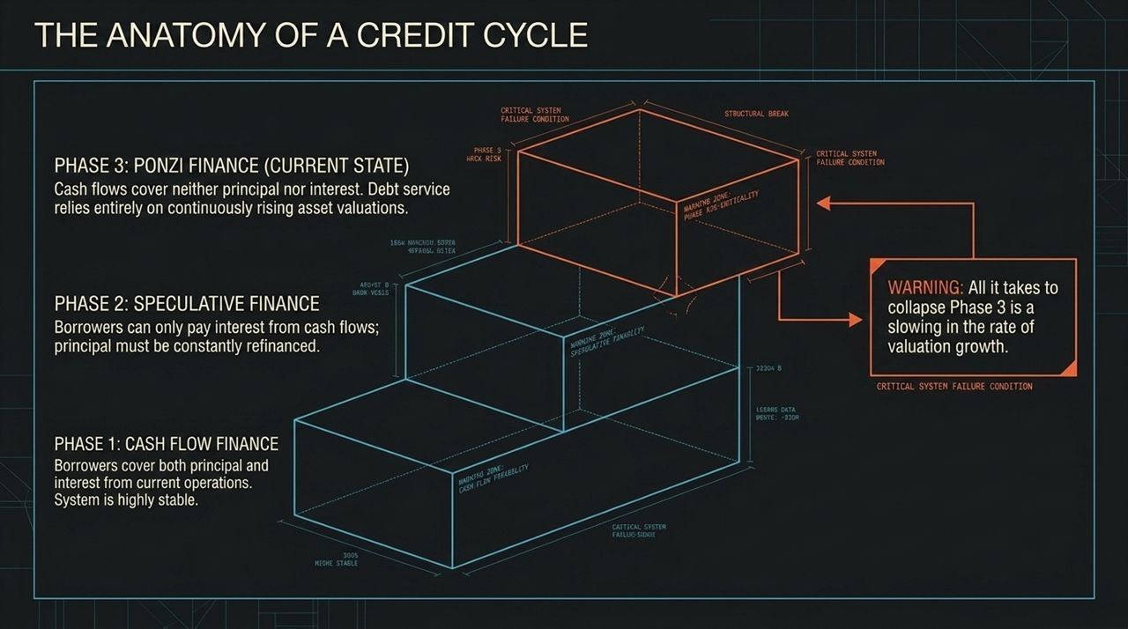
Notes:
To understand where we are, we must look at Hyman Minsky’s classic framework of the credit cycle:
Phase 1 (Cash Flow Finance): Highly stable. Borrowers cover both principal and interest from ongoing operational cash flows.
Phase 2 (Speculative Finance): Cash flows cover interest payments, but principal must be continuously rolled over/refinanced.
Phase 3 (Ponzi Finance - Our Current State): Cash flows cover neither principal nor interest. Debt servicing relies entirely on the assumption of continuously rising asset valuations.
Critical Warning: In Phase 3, you do not need negative growth or a collapse in fundamentals for the system to break. All it takes is a slowing in the rate of valuation growth—a second derivative slowdown.
As Dowd notes, when valuations slow, the leverage required to fund these structures evaporates, leading to systemic structural breaks.

Slide 4
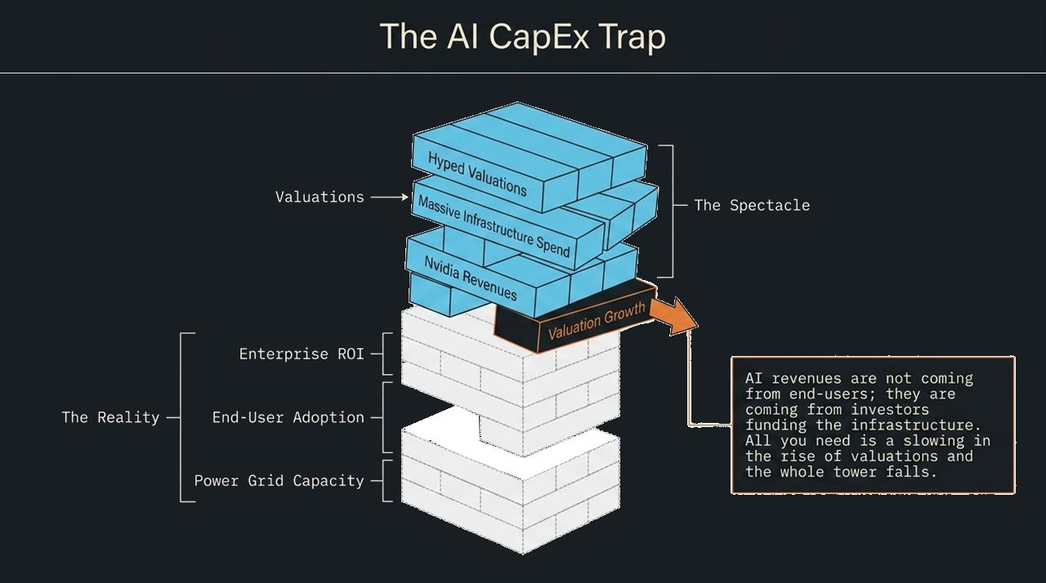
Notes:
Let’s analyze the mechanics of the AI CapEx Trap.
The Spectacle vs. The Reality:
The Spectacle: Hyped valuations, massive infrastructure spending, and skyrocketing revenues for chipmaker pick-and-shovel plays like Nvidia.
The Reality: Slower-than-expected end-user adoption, lack of measurable enterprise ROI, and physical constraints like power grid capacity.
AI infrastructure buildouts are currently financed by money flowing from investors betting on future growth rather than actual revenues generated from paying end-users.
Furthermore, AI models are rapidly becoming commoditized with free open-source alternatives driving pricing down. Coupled with power grid limits, capital spend is hitting a physical and financial ceiling.

Slide 5
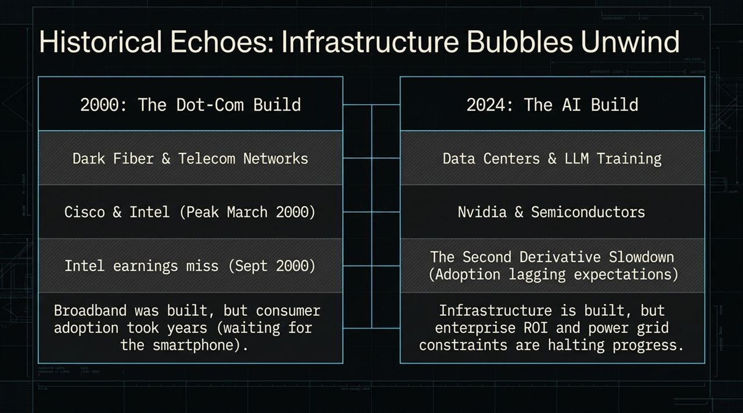
Notes:
Market history doesn't repeat identically, but it rhymes. Compare today’s AI buildout to the 2000 Dot-Com Bubble:
2000 Build: Dark Fiber & Telecom Networks (Cisco/Intel peak in March 2000).
2024 Build: Data Centers & LLM Training (Nvidia & Semiconductors).
The Timeline Lesson: In 2000, the NASDAQ peaked in March, but the S&P 500 traded sideways for 9 months. The bad fundamentals didn’t show up in headlines until September 2000, when Intel reported its first earnings miss.
Adoption Lag: Broadband was built out in 2000, but consumer utility and mobile ecosystems took years to catch up. Similarly, today’s data center infrastructure is being built out at a pace that far outstrips enterprise monetization.

Slide 6
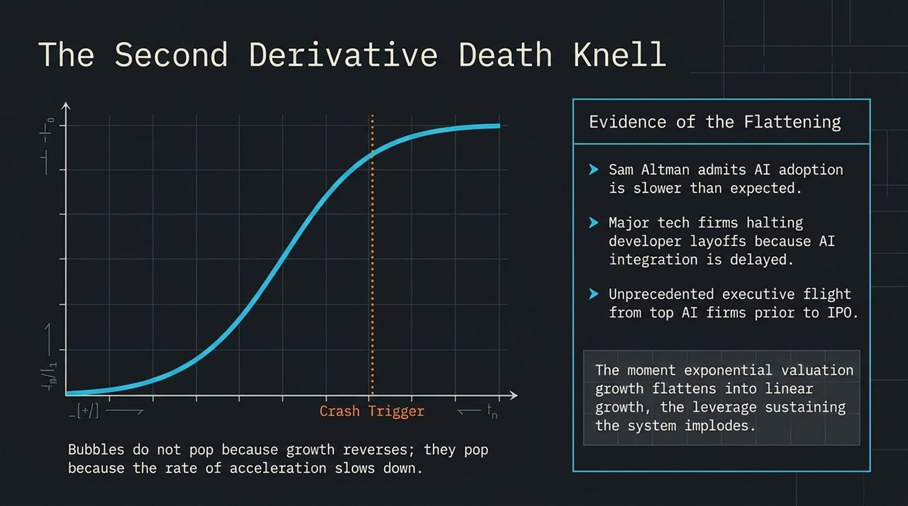
Notes:
The chart on this slide represents the classic S-Curve adoption profile. The dotted line marks our Crash Trigger ($t_{c}$)—the inflection point where acceleration turns into deceleration.
Key Evidence of Flattening:
Industry leaders like Sam Altman openly acknowledging that enterprise AI adoption is moving slower than initial hype projected.
Enterprise tech firms delaying planned developer layoffs because AI integration isn't ready to handle full operational workloads.
Executive flight across prominent AI startups ahead of delayed IPO timelines.
Core Insight: Bubbles do not pop because growth turns negative; they pop the moment exponential growth flattens into linear growth.

Slide 7
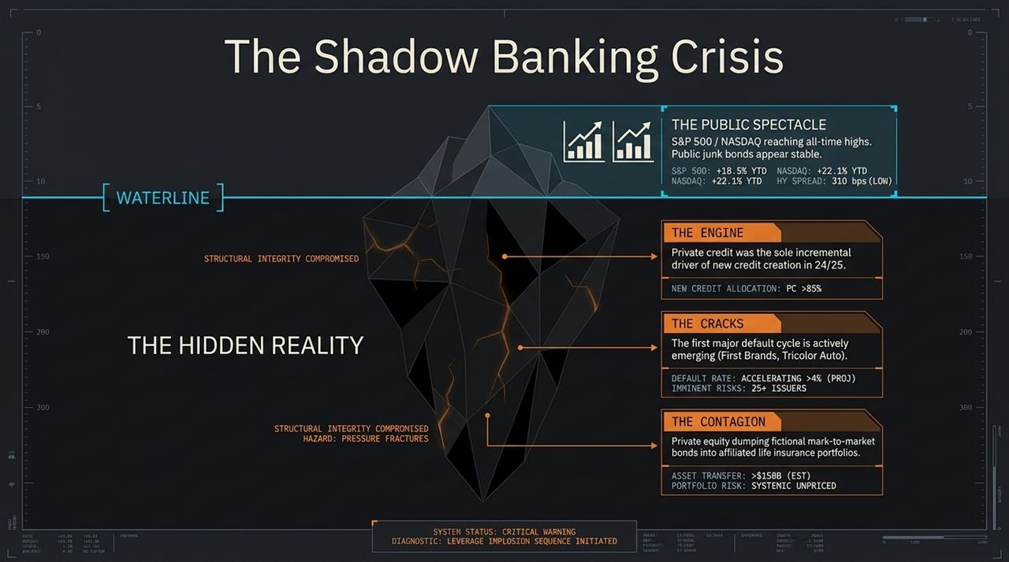
Notes:
While public markets present a sunny spectacle—S&P and NASDAQ near highs with low high-yield spreads—the Hidden Reality beneath the waterline is alarming:
The Engine: Private credit accounted for >85% of incremental new credit creation in 2024/2025.
The Cracks: We are seeing the first major default cycles in private credit issuers (e.g., First Brands, Tricolor Auto), with default rates projected to exceed 4%.
The Contagion: Private equity firms have increasingly offloaded unlisted, fictional mark-to-market debt into affiliated life insurance and annuity portfolios (over $158B estimated).
Because private credit is opaque and marked internally rather than on public exchanges, these losses remain unpriced until liquidity redemption demands force a fire sale.

Slide 8
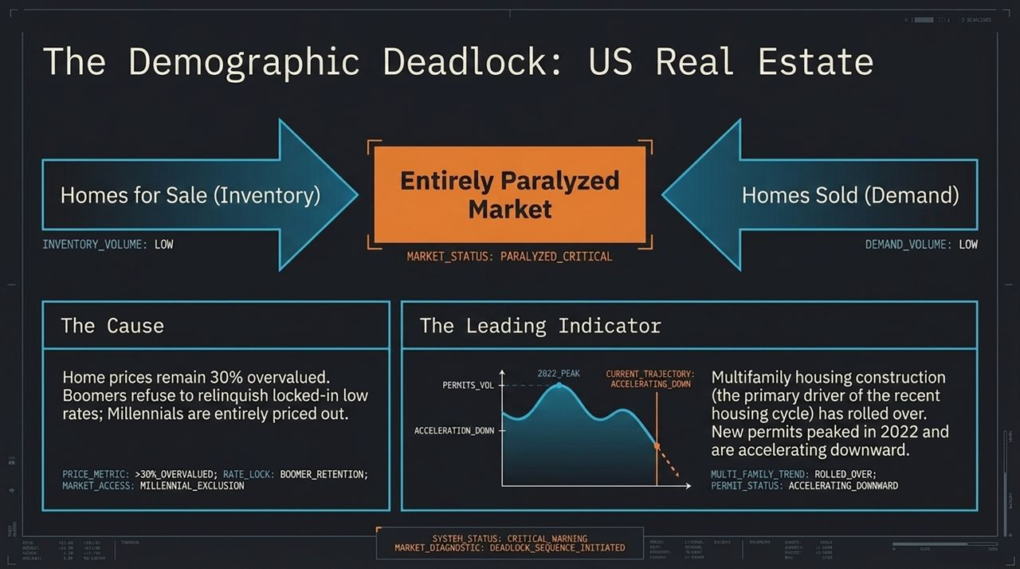
Notes:
The US housing market is in a state of critical paralysis:
Inventory & Demand: Both inventory volume and demand volume are at historic lows.
The Cause: Home prices are roughly 30% overvalued relative to incomes. Baby Boomers refuse to give up locked-in low mortgage rates (3%), while Millennials are completely priced out by 7%+ rates.
The Leading Indicator: Multifamily housing construction—which drove the recent housing cycle—has completely rolled over. New building permits peaked in 2022 and are accelerating downward.
Frozen markets eventually move, and when forced liquidations or economic slowdowns occur, prices adjust downward to meet consumer reality.

Slide 9
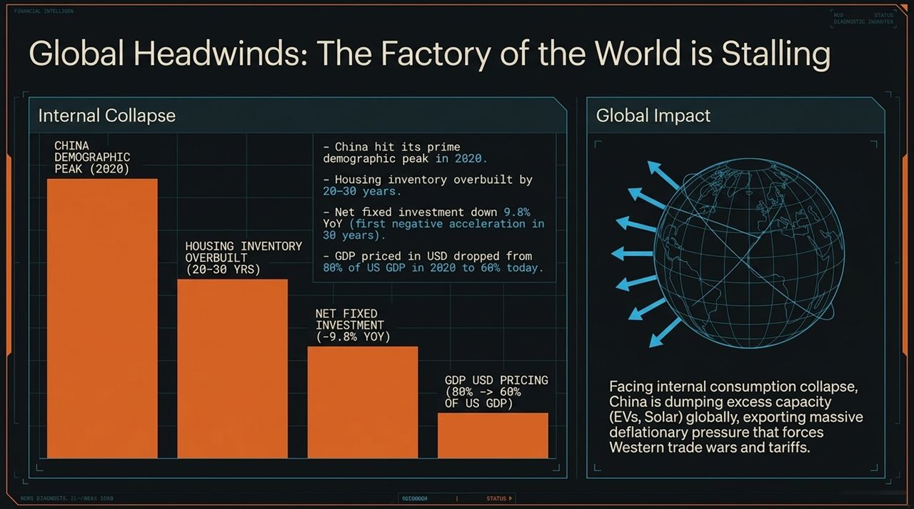
Notes:
We cannot analyze the US in a vacuum; China's economic engine is stalling:
Internal Demographics: China hit its prime working-age demographic peak in 2020.
Overbuilt Infrastructure: Housing inventory is overbuilt by 20 to 30 years.
Negative Net Fixed Investment: Net fixed investment declined -9.8% YoY—its first negative multi-quarter contraction in 30 years.
GDP Contraction in USD: China's GDP priced in USD dropped from 80% of US GDP in 2020 down to ~60% today.
Global Impact: Unable to stimulate internal consumption, China is dumping subsidized excess capacity (EVs, solar, batteries) into global trade channels, triggering tariffs, trade friction, and exporting deflationary pressure worldwide.

Slide 10
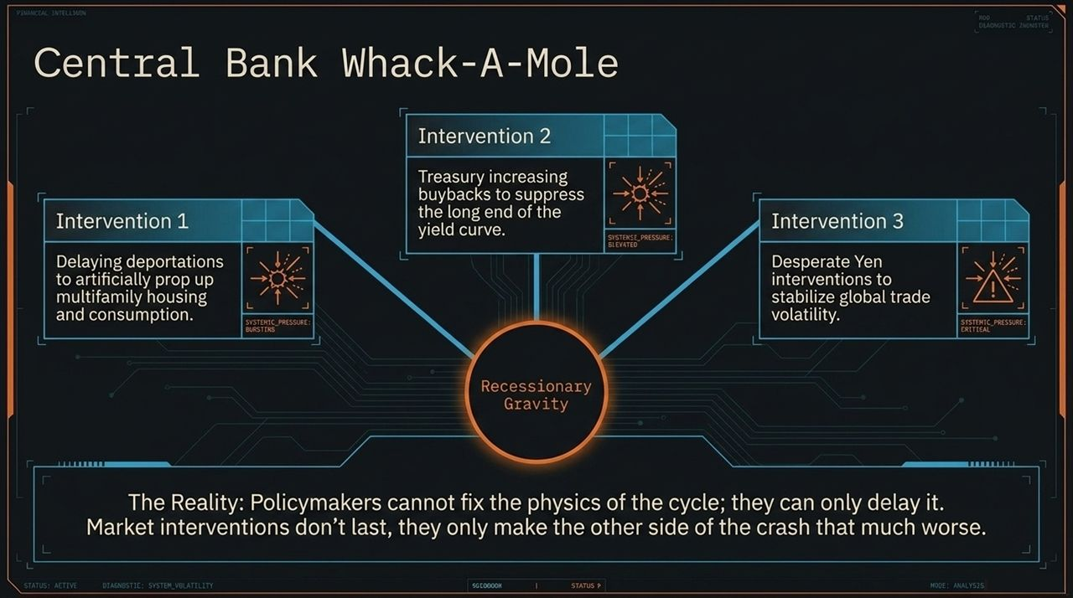
Notes:
Central banks and fiscal authorities are playing an unsustainable game of Whack-A-Mole:
Intervention 1: Slow-walking deportations or managing border flows to artificially sustain multifamily rental demand and baseline consumption.
Intervention 2: US Treasury buyback programs aiming to suppress long-end yield spikes.
Intervention 3: Desperate Yen interventions by the Bank of Japan to manage currency volatility and carry-trade unwinds.
The Reality: Policy interventions do not change economic physics; they merely delay the resolution, accumulating market leverage and making the ultimate correction more severe.

Slide 11
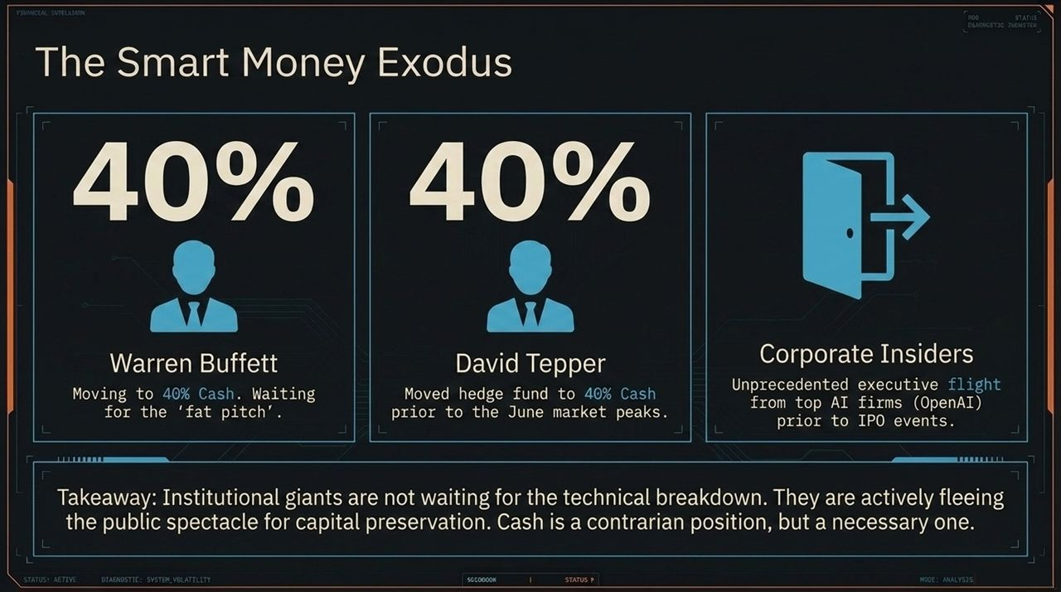
Notes:
Institutional "Smart Money" is not waiting for a formal technical breakdown; they are quietly building defense:
Warren Buffett (Berkshire Hathaway): Cash reserves raised to record levels near 40%, waiting for a true "fat pitch" valuation.
David Tepper (Appaloosa Management): Shifted fund allocation to 40% Cash prior to summer market highs.
Corporate Insiders: High-profile departures from major AI entities (e.g., OpenAI leadership) ahead of projected liquidity/IPO events.
When smart money raises cash, it isn't out of panic; it is a strategic maneuver to preserve capital for post-crash distress opportunities.

Slide 12
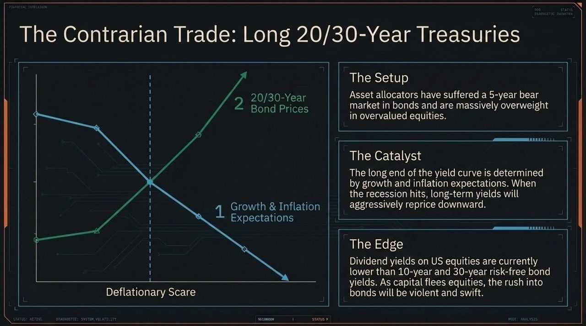
Notes:
As a deflationary scare takes hold, we see a key asymmetric trade: Long Long-Term US Treasuries (20/30-Year Bonds).
The Setup: Asset allocators are heavily overweight equities and underweight bonds after a brutal 5-year bear market in fixed income.
The Catalyst: Long-term yields are governed by long-term growth and inflation expectations. When recessionary reality hits, inflation expectations plunge, forcing long-end yields down and bond prices sharply higher.
The Edge: Equity dividend yields are currently below risk-free treasury yields. As equity valuations reprice, institutional capital flight into long-duration bonds will be swift and aggressive.

Slide 13
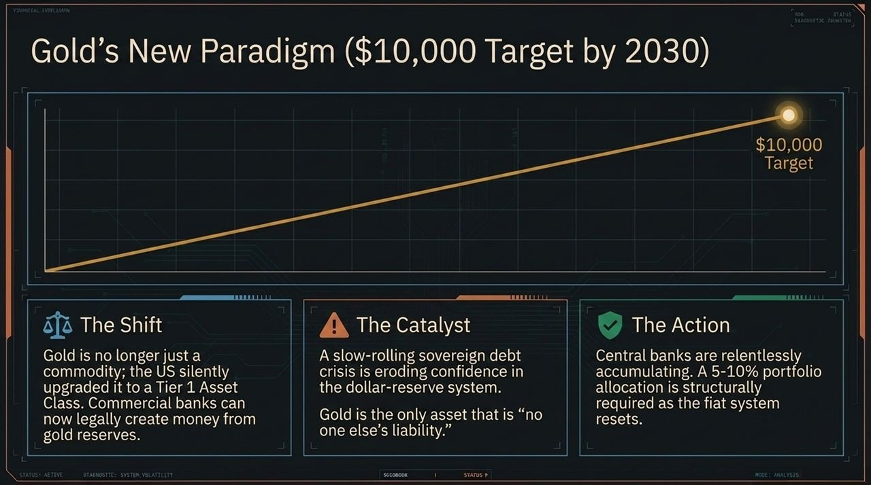
Notes:
Gold has entered a structural paradigm shift:
Tier 1 Asset Status: Gold was reclassified as a Tier 1 Asset for commercial bank reserves. It is no longer viewed simply as a commodity, but as reserve money without counterparty risk.
Sovereign Debt Crisis: Escalating fiscal deficits and global currency debasement are forcing central banks to aggressively accumulate physical gold.
Target: As fiat systems undergo recalibration, gold is targeting $10,000/oz by 2030.
A 5–10% portfolio allocation serves as a necessary structural hedge against sovereign debt and monetary reset risks.

Slide 14
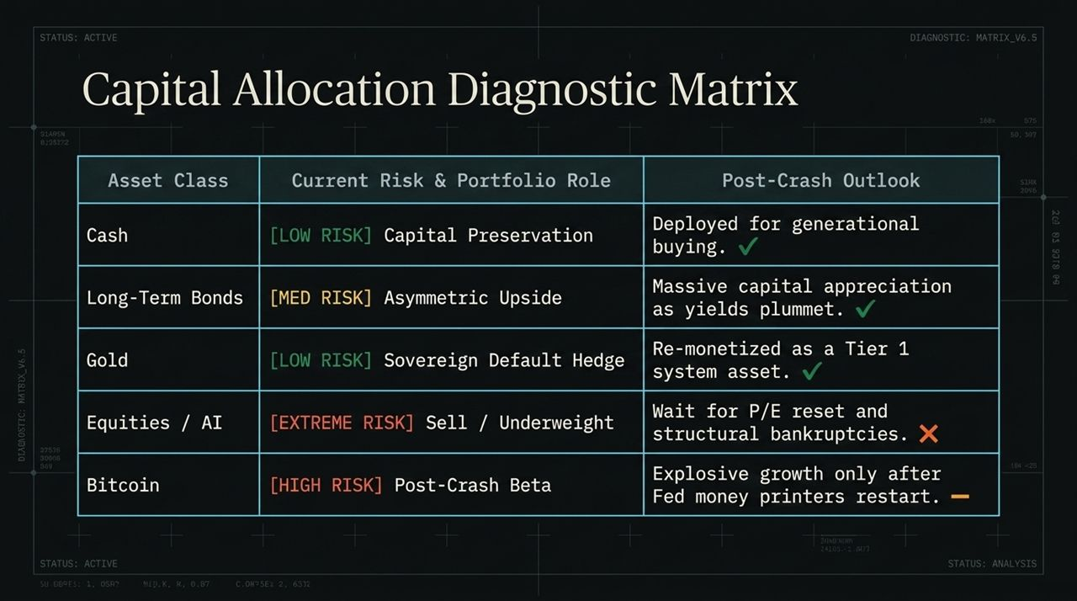
Notes:
Here is our strategic capital allocation matrix leading into and through the reset:
Cash [Low Risk]: Maintain high cash balances now for capital preservation. Deploy post-crash for generational buying opportunities.
Long-Term Bonds [Med Risk]: High asymmetric upside as yields plunge during the growth shock.
Gold [Low Risk]: Core sovereign default hedge.
Equities / AI [Extreme Risk]: Underweight/Sell. Wait for valuation/PE resets and bankruptcy clearances before re-entering.
Bitcoin [High Risk]: Treat as high-beta risk asset in the short term; deploy aggressively once liquidity injection and monetary debasement resume post-crash.

Slide 15
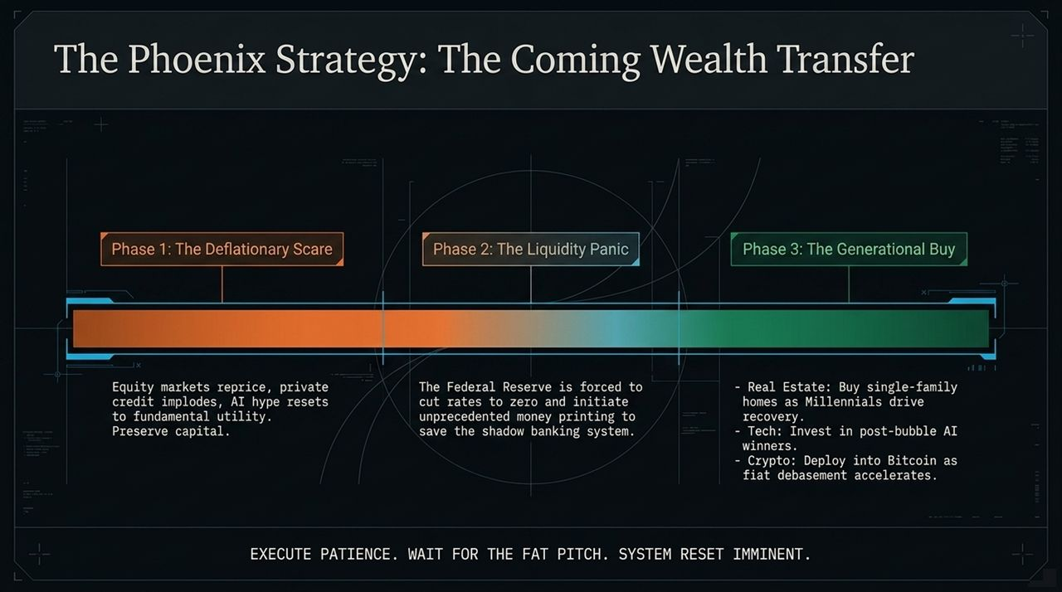
Notes:
The Phoenix Strategy outlines our 3-phase roadmap to navigate the coming wealth transfer:
Phase 1: The Deflationary Scare: Equity markets reprice, private credit implodes, and AI hype resets to core utility. Action: Preserve capital and hold cash/bonds.
Phase 2: The Liquidity Panic: Central banks cut rates to zero and initiate emergency liquidity programs to save shadow banking. Action: Prepare deployment lists.
Phase 3: The Generational Buy: Deploy capital into single-family real estate, post-bubble tech/AI winners, and Bitcoin as monetary debasement accelerates.
Bottom Line: Execute patience and wait for the fat pitch.

Slide 16
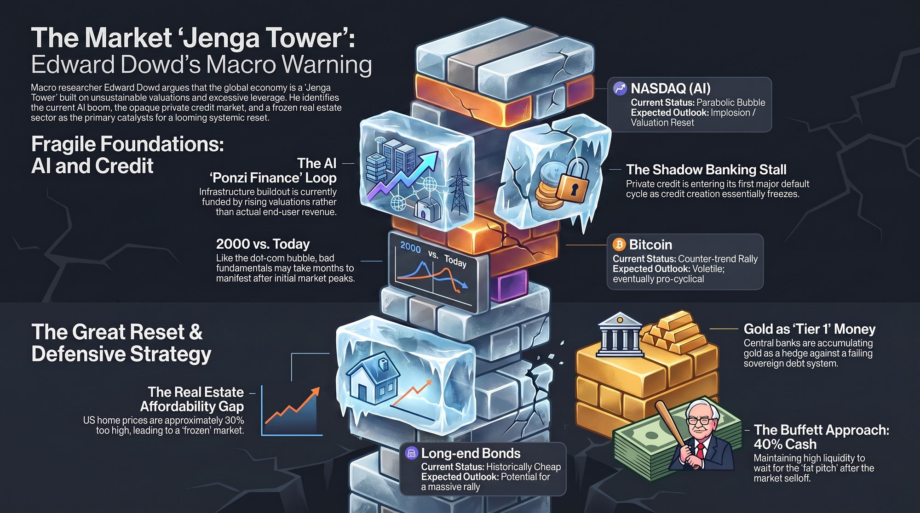
Notes:
To conclude, Slide 16 summarizes Edward Dowd’s overarching macro thesis:
The AI Ponzi Loop: AI CapEx is currently sustained by rising valuations rather than end-user revenues.
Credit & Real Estate Paralysis: Private credit default cycles are emerging, while 30% overvalued real estate keeps transaction volumes locked.
Asset Positioning Summary:
NASDAQ/AI: Parabolic bubble prone to valuation reset.
Bitcoin: Short-term correlation with risk assets, followed by pro-cyclical surge during monetary response.
Gold: Accumulate as Tier 1 reserve asset.
Long Bonds: Unprecedented rally potential as growth/inflation expectations fall.
Cash (The Buffett Approach): Maintain 40%+ liquidity to capture post-selloff opportunities.

